Slide 1


Session // 02 ARTIFICIAL NEURAL NETWORKS FACULTY OF SCIENCE AND ENGINEERING +++
Diego Corona Lopez – AI Technical Specialist

Slide 2
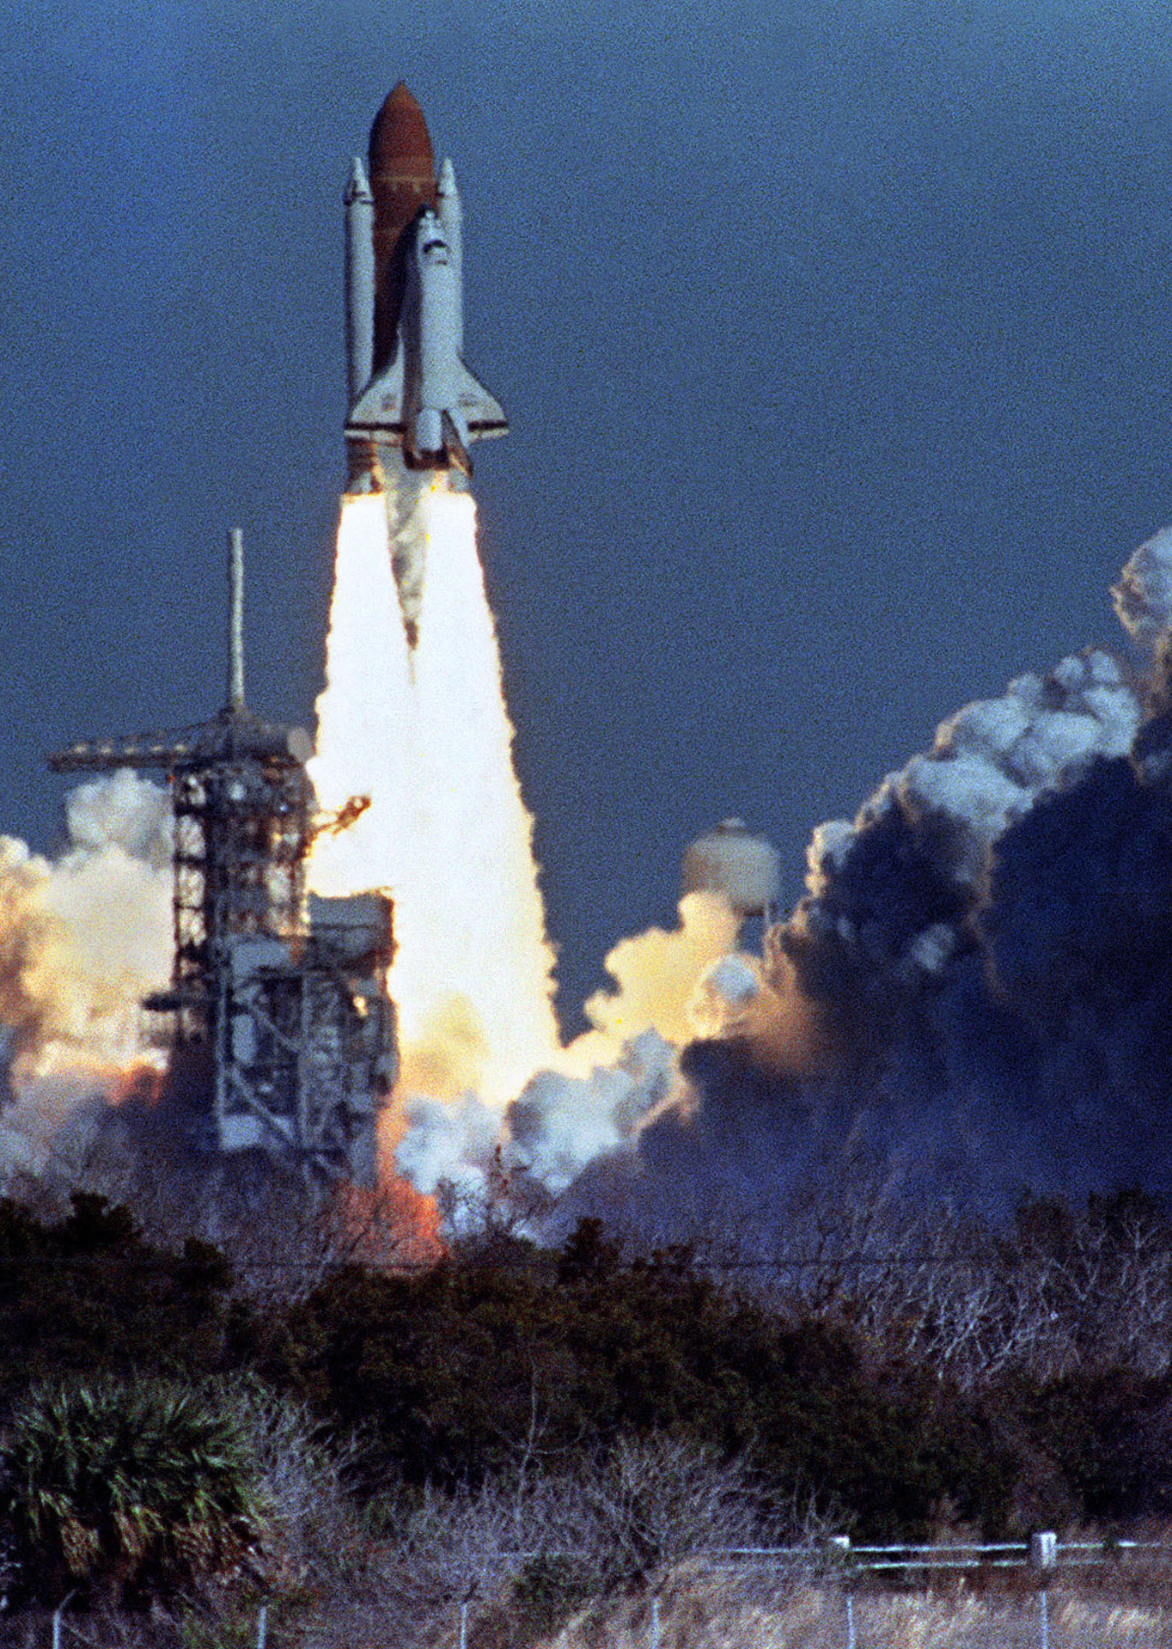
Agenda
Introduction to Artificial Neural Networks
Understanding neural networks and their components
Exploring neuron structure and activation functions
Implementing a Neuron in PyTorch
Hands-on coding: Building a perceptron model
Exercise: Creating our first neural network component
Case Study: Space Shuttle Challenger
Historical context of the disaster
Introduction to the O-ring dataset
Data Preparation and Model Design
Exercise: Preprocessing temperature and O-ring data
Converting, normalizing and structuring data for neural networks
Training and Evaluation
Exercise: Implementing loss functions and model training
Visualizing model performance and understanding convergence
Risk Analysis and Ethical Implications
Exercise: Predicting O-ring failure at Challenger launch temperature
Discussion: Data science ethics and responsibility

Slide 3
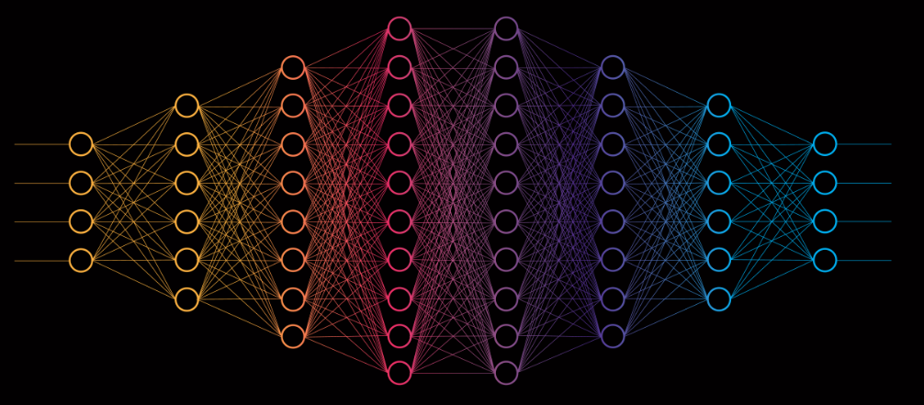
What Are Artificial Neural Networks?
ANNs are computational models inspired by the human brain's neural structure. They consist of interconnected neurons organized in layers that transform input data into meaningful outputs. Each neuron performs weighted calculations on its inputs and applies an activation function to introduce non-linearity.

Slide 4
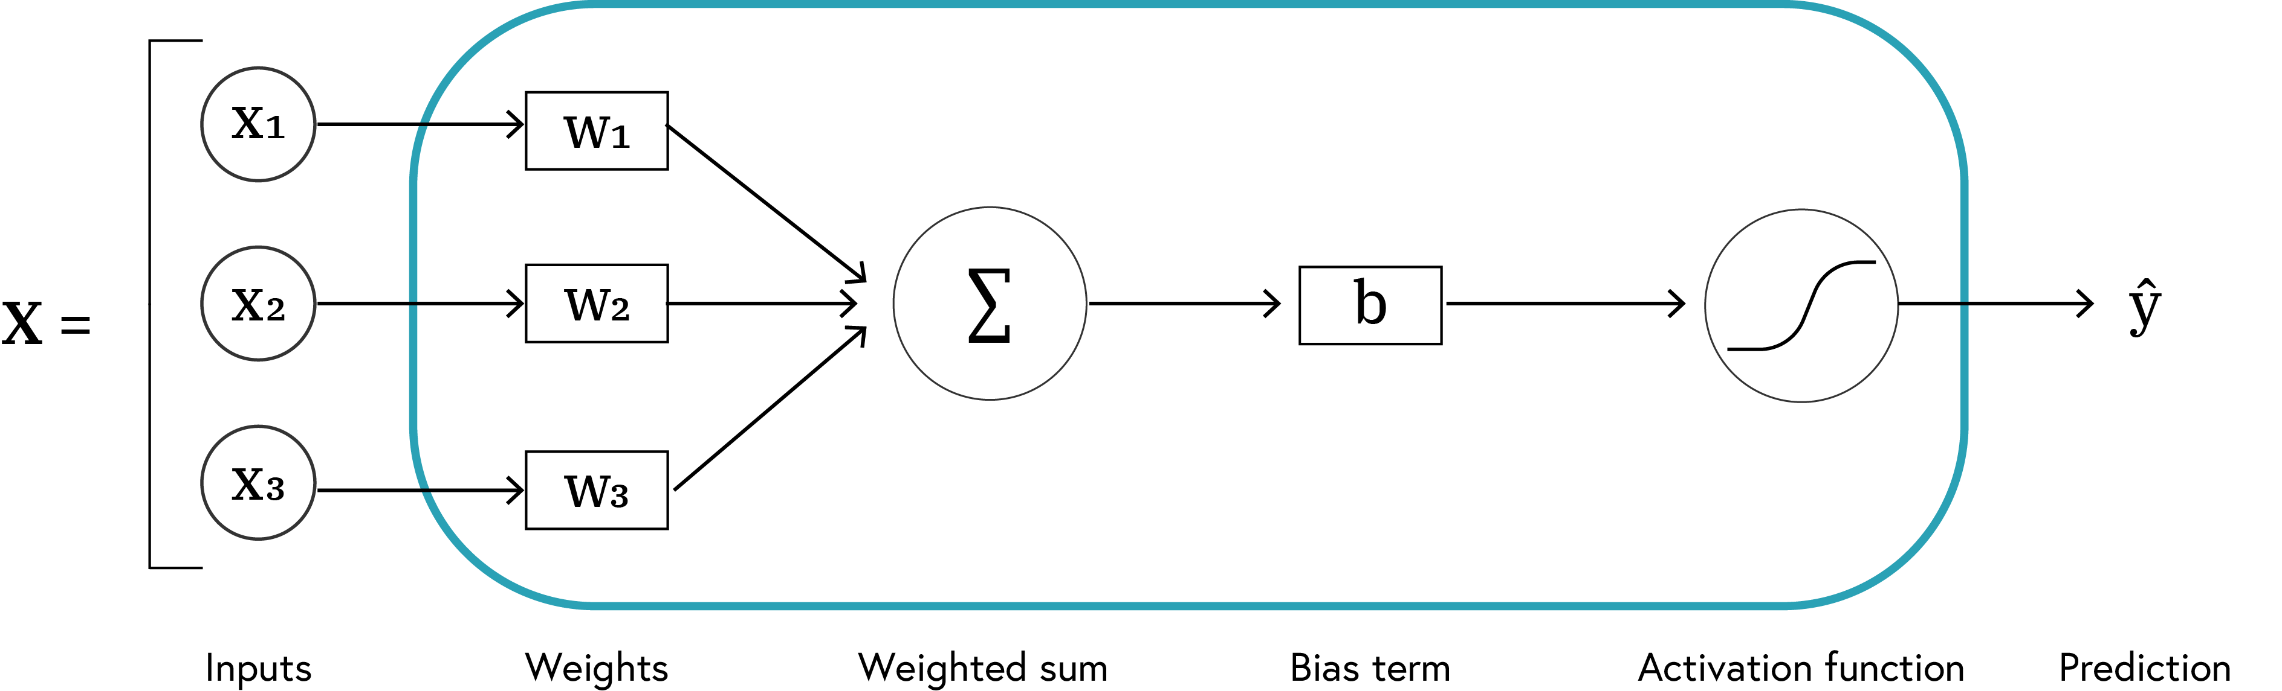

Anatomy of a Neuron
Basic computational units of neural networks
Each neuron:
Receives inputs
Applies weights and bias
Processes through activation function
Produces output
$$\hat{y}=f\left(W⋅X+b\right)$$

Slide 5
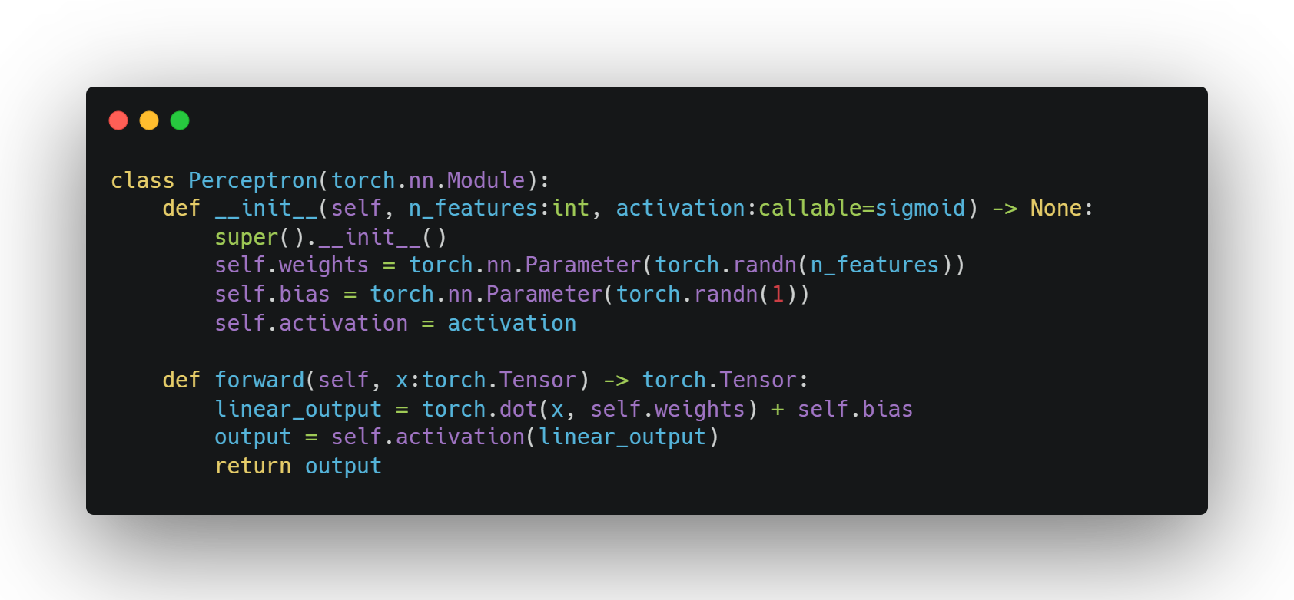
Implementing a Neuron
SE01
07

Slide 6
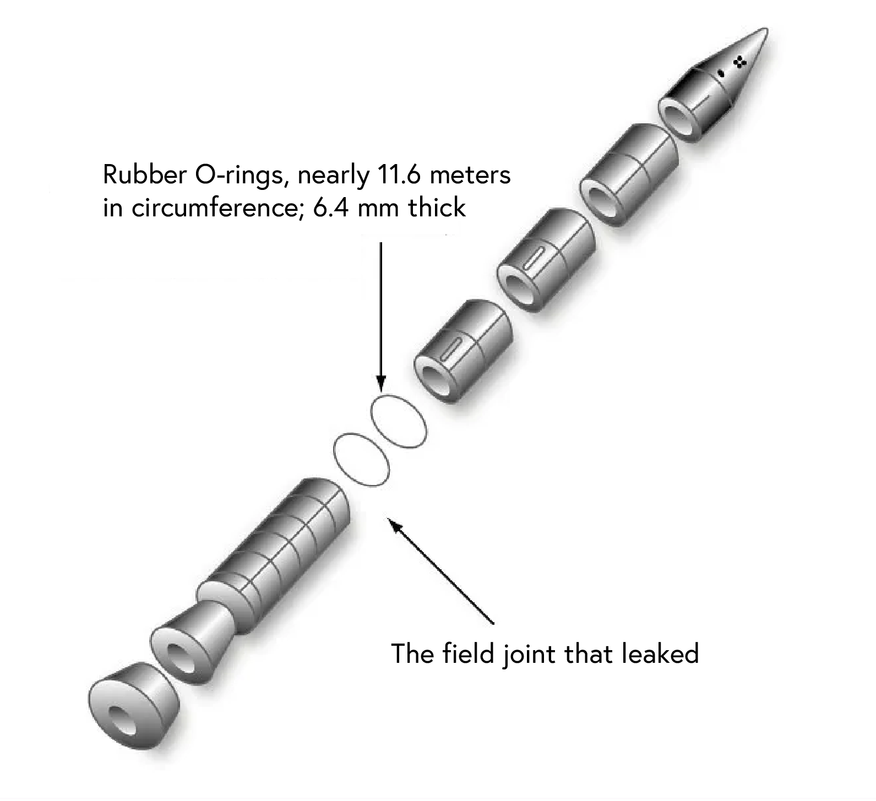
The Space Shuttle Challenger Disaster
January 28, 1986: Space Shuttle Challenger exploded 73 seconds after launch
Cause: O-ring failure due to low temperatures
Question: Could data analysis have prevented this tragedy?

Slide 7
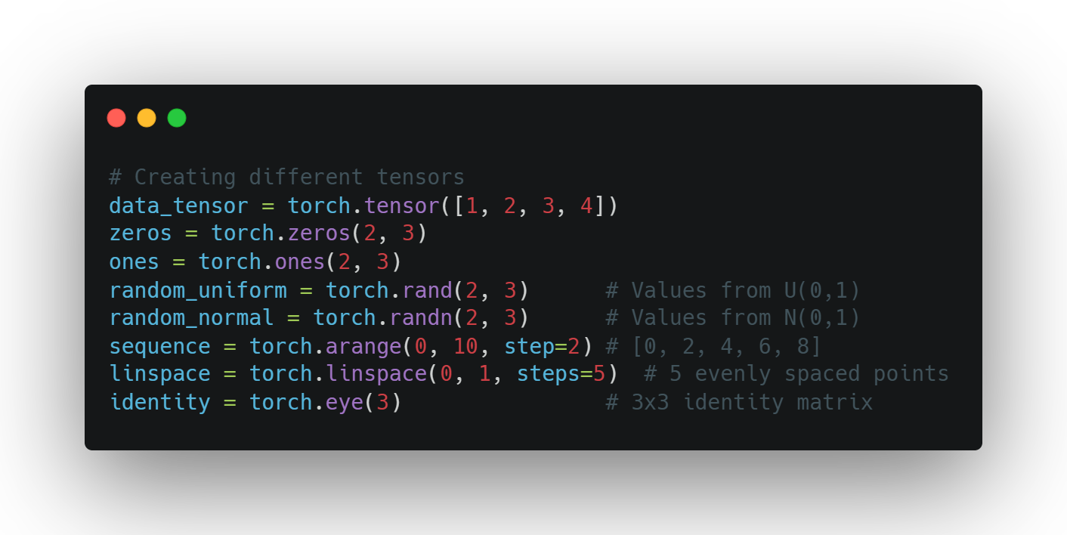
Creating Tensors
Basic Tensor Creation Methods
torch.tensor() - from existing data
torch.zeros(), torch.ones() - filled tensors
torch.rand(), torch.randn() - random tensors
torch.arange(), torch.linspace() - sequences
torch.eye() - identity matrices
Data types can be specified with dtype parameter
SE01
08

Slide 8
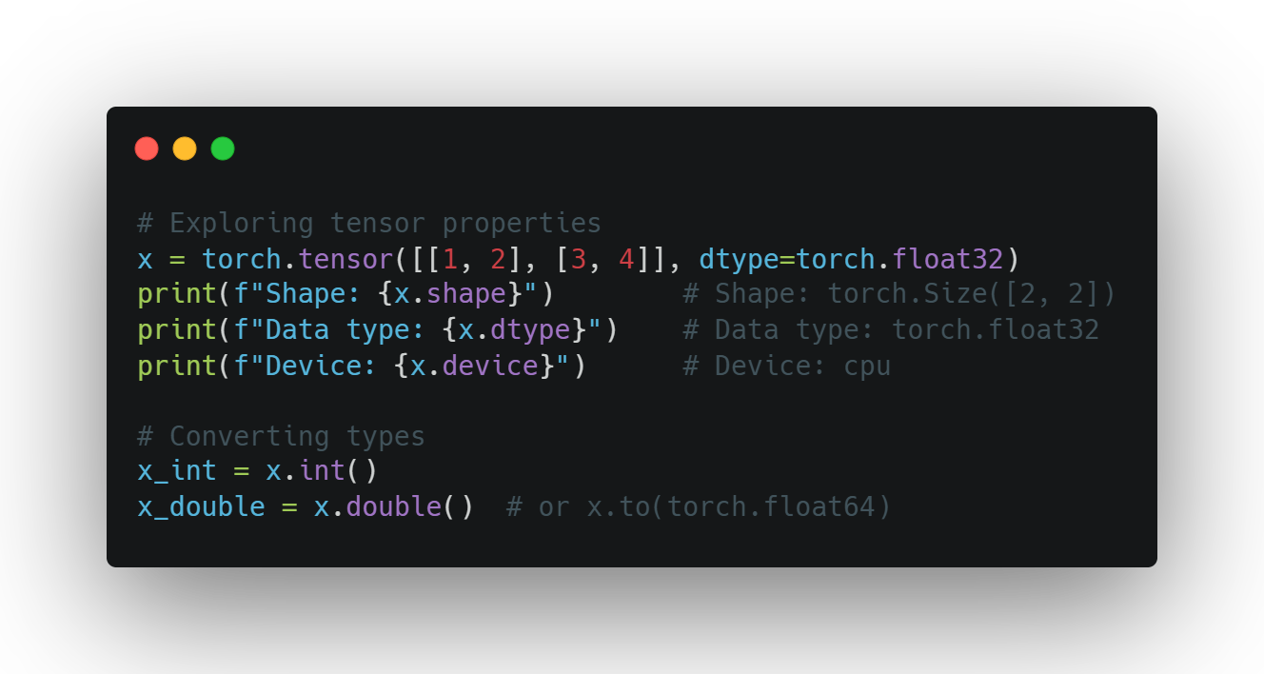
TENSOR
PROPERTIES
Working with Tensor Attributes
Shape: tensor.shape
Data type: tensor.dtype
Device: tensor.device
Accessing values: tensor.item() for scalars
Converting types: tensor.float(), tensor.int()
SE01
09

Slide 9
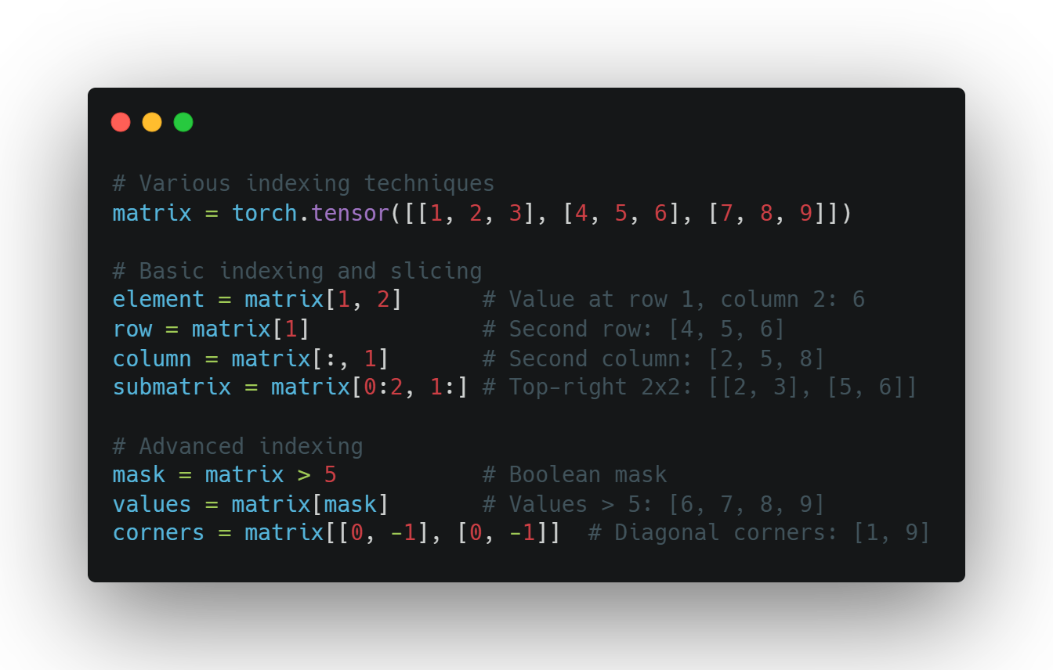
TENSOR
indexing
Accessing Tensor Data
Basic indexing: tensor[i, j]
Slicing: tensor[1:3]
Advanced indexing techniques:
Boolean masks: tensor[tensor > 0]
Negative indexing: tensor[-1] (last element)
Using ellipsis: tensor[..., 0]
SE01
10

Slide 10
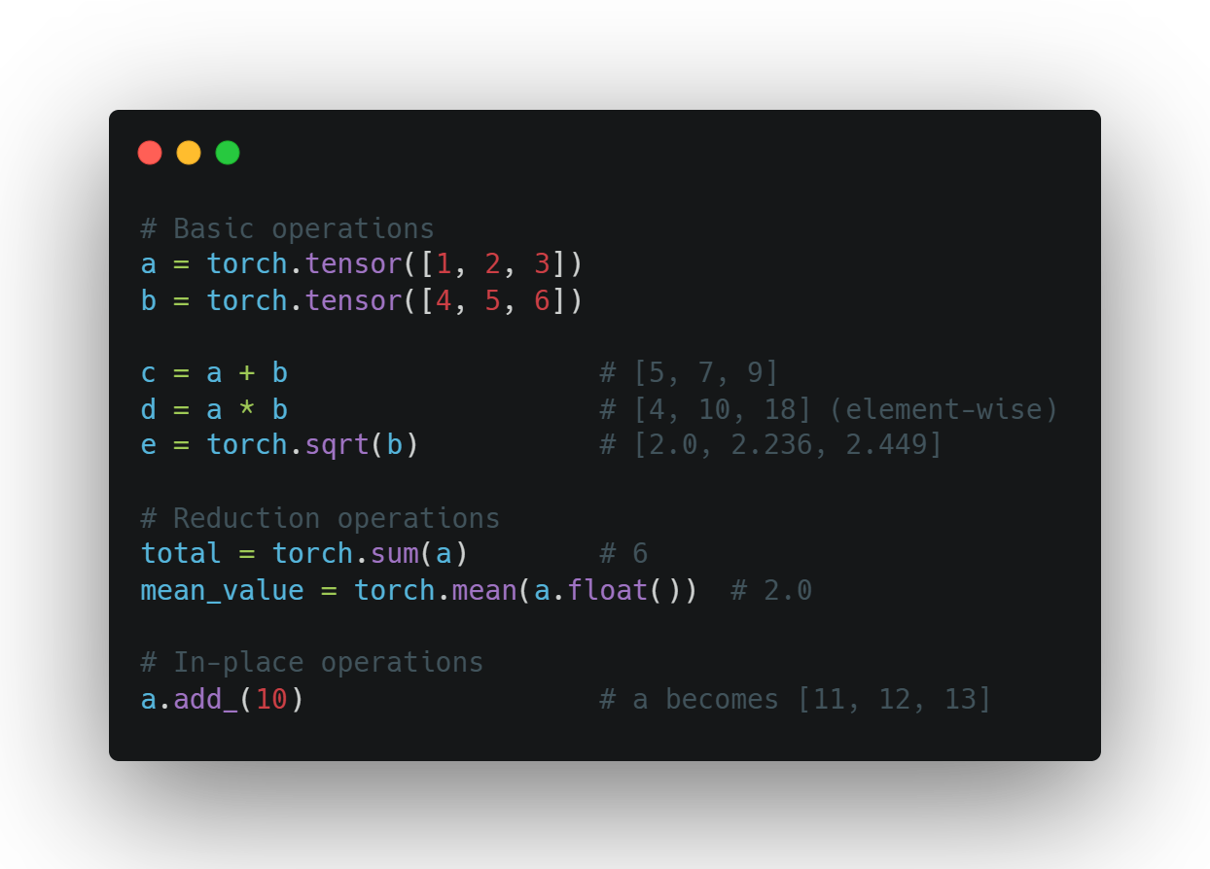
BASIC TENSOR
OPERATIONS
Common Operations
Arithmetic: +, -, *, /
Element-wise operations: torch.sqrt(), torch.pow()
Reduction: torch.sum(), torch.mean()
Comparisons: >, <, ==
In-place operations: tensor.add_(1) (note the underscore)
SE01
11

Slide 11
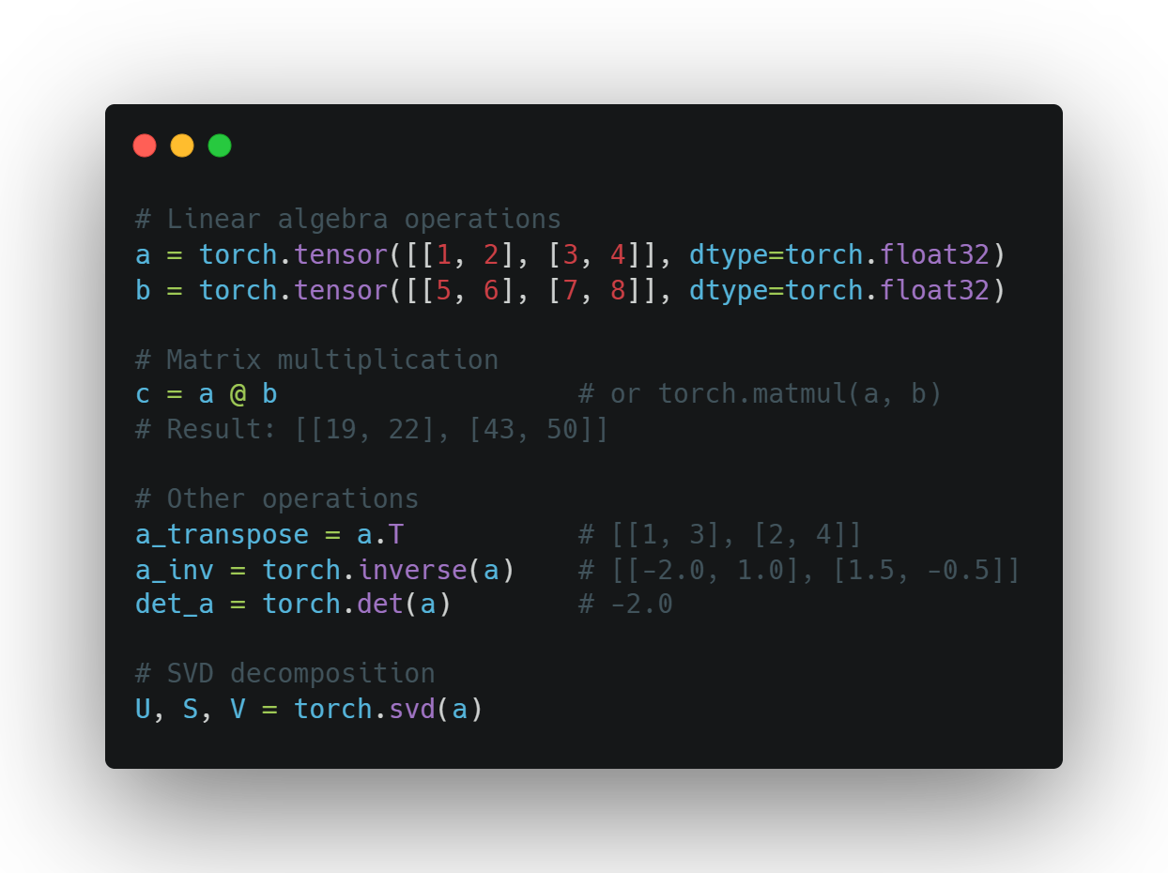
MATRIX
OPERATIONS
Linear Algebra with PyTorch
Matrix multiplication: @ or torch.matmul()
Transposition: .T or torch.transpose()
Inverse: torch.inverse()
Determinant: torch.det()
Eigenvalues: torch.eig()
SVD: torch.svd()
SE01
12

Slide 12
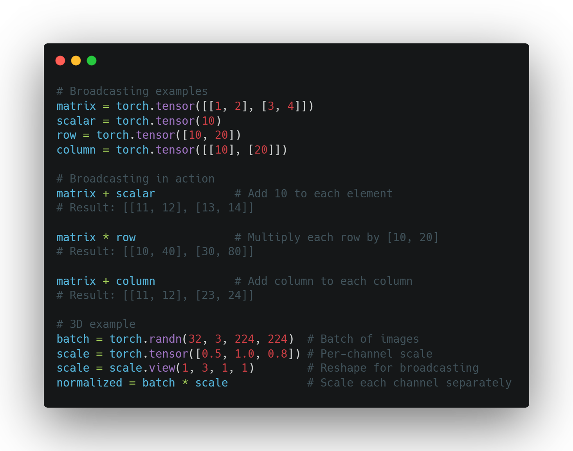
Broadcasting
Working with Different Shapes
Automatic expansion of smaller tensors
Rules follow NumPy broadcasting
Eliminates need for explicit reshaping
Examples:
Add scalar to matrix
Multiply matrix by row/column vector
Scale batches of data
Powerful but requires understanding
SE01
13

Slide 13
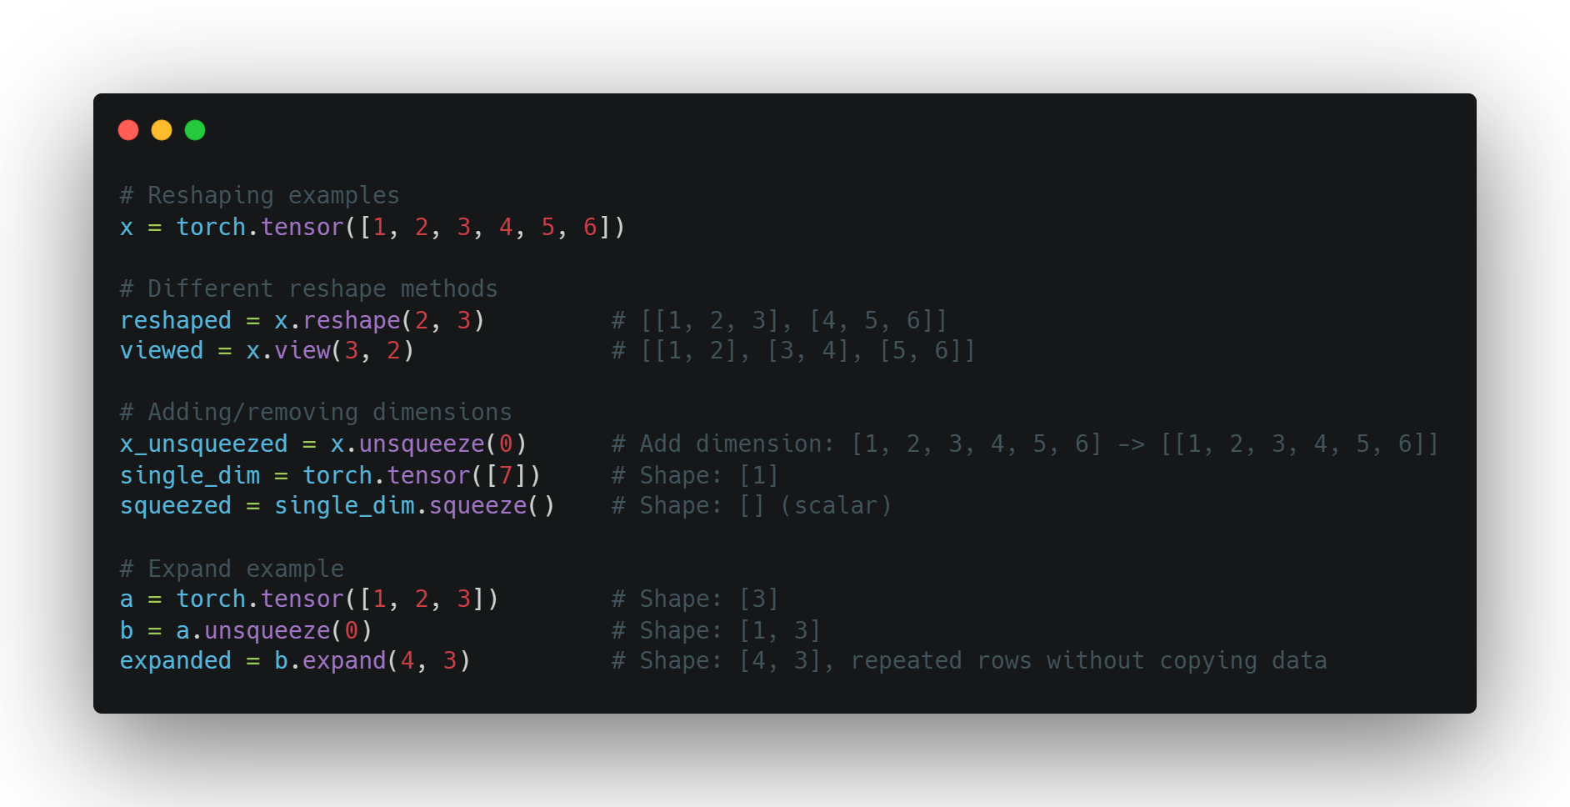
RESHAPING
Changing Tensor Dimensions
reshape() - new shape, possibly new memory
view() - new shape, same memory (must be contiguous)
squeeze() - remove dimensions of size 1
unsqueeze() - add dimension of size 1
expand() - broadcast dimensions without copying
SE01
14

Slide 14
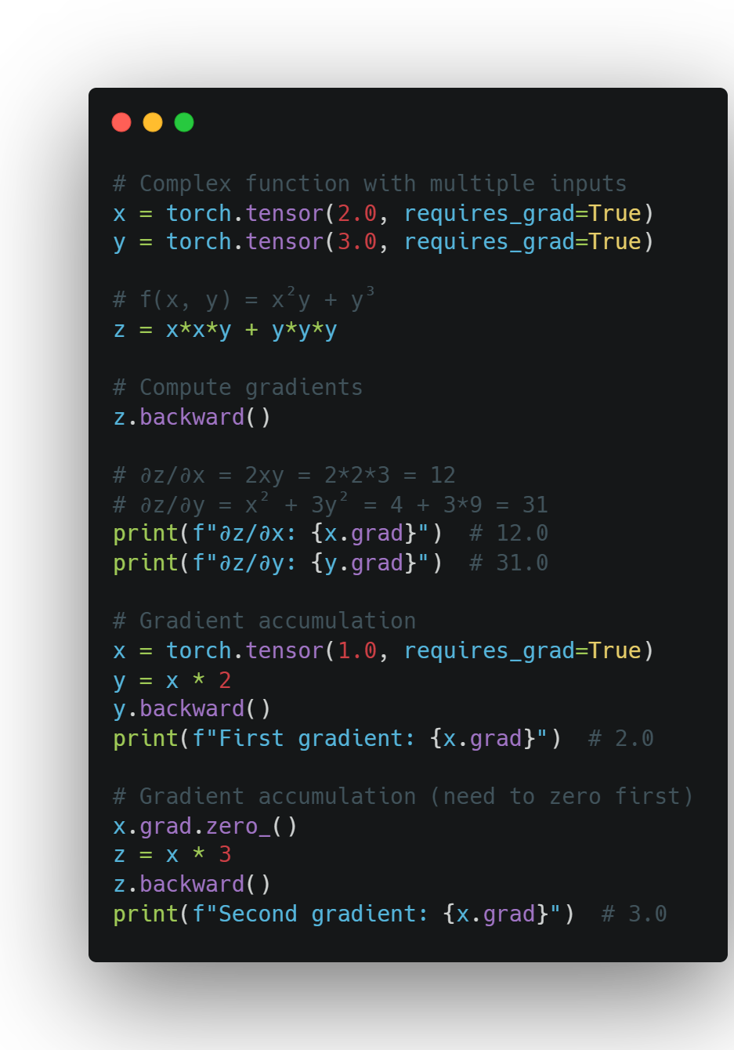
Using autograd
Computing Gradients
Enable tracking with requires_grad=True
Build computation graph through operations
Call backward() to compute gradients
Access gradients via tensor.grad
SE01
15

Slide 15
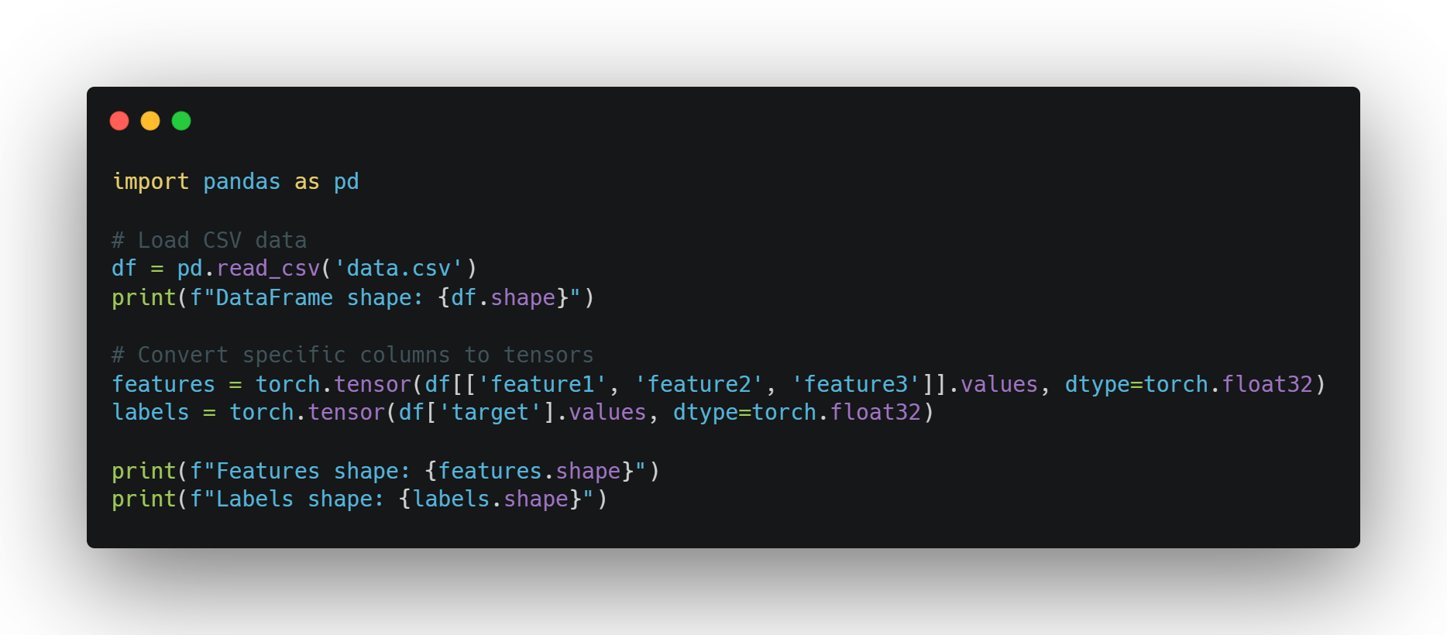
LOADING DATA
From Raw Data to Tensors
Common data sources: CSV, images, text
Using pandas to load structured data
Converting to tensors:
df = pd.read_csv('data.csv')
tensor = torch.tensor(df.values)
DataFrames as an intermediate representation
SE01
16

Slide 16
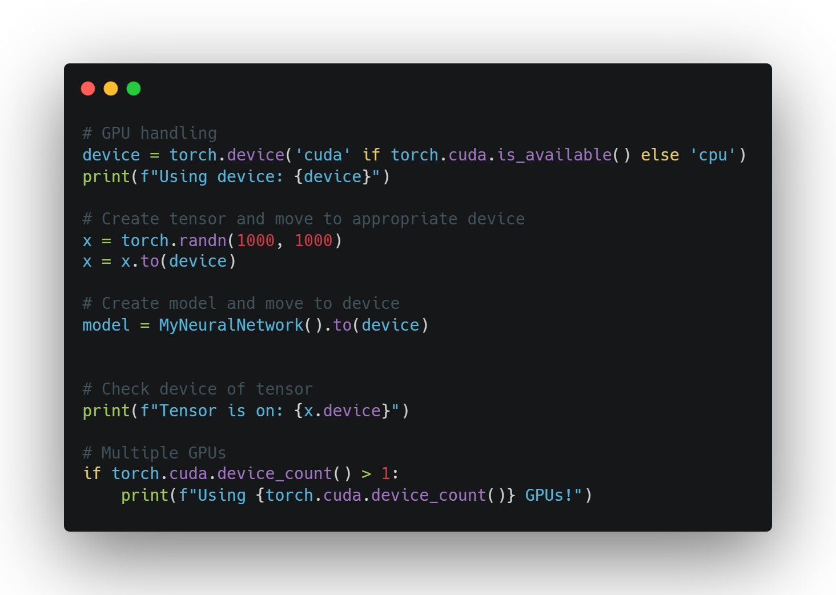
Using
The gpu
Leveraging Hardware
Check availability: torch.cuda.is_available()
Select device: device = torch.device('cuda')
Move tensors to device: tensor = tensor.to(device)
When to use GPU:
Large tensors/datasets
Computationally expensive operations
Deep learning model training
Keep all tensors on same device for efficiency
SE01
17

Slide 17

BEST PRACTICES
Match tensor types before operations
Understand broadcasting rules
Use in-place operations when appropriate
Keep track of your tensor devices
Leverage PyTorch's documentation
Experiment and debug with small examples first

